Slide 1
Service-oriented cloud computing

Slide 2
What is cloud computing?
“cloud computing is the on-demand availability of computer system resources, such as data storage (cloud storage) and computing power, without direct active management by the user .”

Slide 3
What is cloud computing?
Cloud computing is a computing infrastructure and it is used for rapid delivery to computer resources as a utility in a dynamically scalable, virtualize manner.

Slide 4
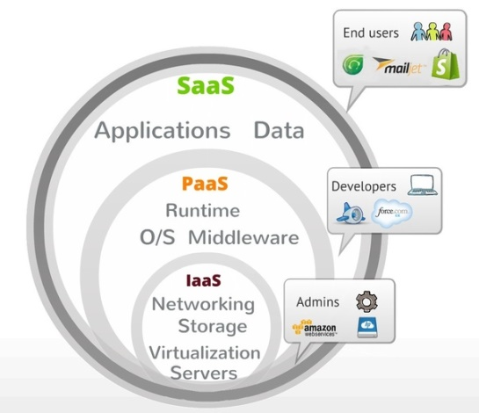
A Hierarchical View of Cloud Computing

Slide 5
A Hierarchical View of Cloud Computing
Infrastructure as a service
Platform as a Service
Software as a Service

Slide 6
Issues with Current Clouds
Users are often tied with one cloud provider
Computing components are tightly coupled
Lack of SLA supports
Lack of Flexibility for User Interface

Slide 7
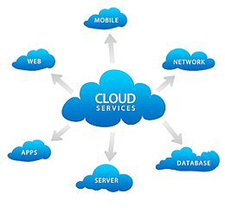
Service-Oriented and Cloud Computing

Slide 8

How SOA support for overcome issues of current cloud computing

Slide 9
Layered architecture of SOCCA
Individual cloud provider layer
Cloud broker layer
SOA layer

Slide 10
Application development on SOCCA
Service Package
Compiled code
Source code
Configuration file

Slide 11
Advantages of SOCCA
A new multi tenancy pattern single instance and multiple service instance becomes possible with SOCCA.
SOCCA allows application to run on other cloud and interoperate with each other.
SOCCA support easy migration of application from one cloud to another.
SOCCA provides better support for Multi tenancy feature.

Slide 12
Disadvantages of SOCCA
SOCCA does not provide any modeling language to map different language sets as different clouds supports different language sets.
Instances for the same service cannot live on multiple clouds.

Slide 13
Thank you

